Slide 1

Revolutionizing Apparel Retail in Africa

Slide 2




The Problem
Apparel retailers lack the technology, logistics and capital to scale.
Reina owns a small store. But, Reina’s growth is slow...
Inflated Cost of Goods
Inefficient Logistics
No Access To Capital

Slide 3




The Solution
ZUMI puts eCommerce technology in the hands of informal retailers.
Order Online
Easy Logistics
Growth Capital
Low Prices
Mobile platform enables retailers to restock at the click of a button.
ZUMI makes delivery to retailers hassle-free.
ZUMI evaluates retailers for credit to scale the growth.
Sourcing in bulk enables ZUMI to offer lower prices to retailers.

Slide 4

Traction
Early traction has proven positive unit economics and rapid scalability.
Revenue Growth
125k USD
Monthly Revenue
$125,000
90k
USD
Customer Return Rate
75%
63k
USD
Monthly Growth Rate
25%
40k
USD
Month 1
Month 2
Month 3
Month 4

Slide 5
Market Size
$31 Billion
1.7m
20k
Total Apparel Market in Africa
Source: Euromonitor
Total Potential Retailers
Projected ZUMI Retailers by 2025

Slide 6
Market Size
20k
$5k
$100m
Projected ZUMI Retailers in 2025
Annual Revenue per Informal Retailer
Source: Order Data
Projected ZUMI Revenue in 2025

Slide 7





Why Now?
Winner takes all race to bring informal retail online…
Apparel
Food
FMCG
Pharma

Slide 8





Business Model
A lean, asset-light model that's built for scale.
1
2
3
4
5
Sales agents onboard retailers and propose the best products.
Retailers order on mobile or with an agent.
ZUMI collects orders from suppliers early each morning.
ZUMI delivers same day and takes a 15% commission.
Customers pay on delivery with mobile money.

Slide 9


Validated Business Model
ZUMI is replicating an existing business model in the untapped African market of 1.2 billion people.
International Comparables:
Zilingo, SE Asia
$900m Valuation in 2019
Udaan, India
$2 billion Annual Sales

Slide 10

Competition
Our competition is an offline, traditional market that is rife with systemic problems…
High Cost Of Goods
Complex Logistics
No Access To Credit

Slide 11


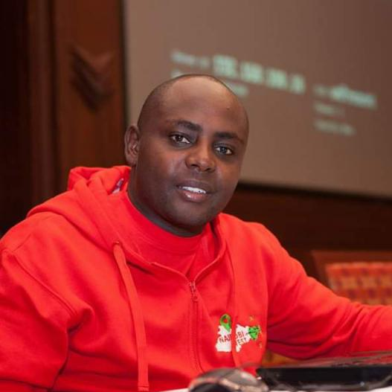








Leadership Team
Execution focused team with extensive experience in e-commerce and logistics.
William McCarren
CEO
---
Nottingham University
7 years exp. Amazon, Jumia, Rocket Internet
Calvin Ayugi
VP, Operations
---
MSc Logistics, Jomo Kenyatta University
7 years exp. Jumia, Telkom
Chris Muasya
Head of Sales
---
10 years exp. Safaricom,
Coca-Cola, SafeBoda
Sabrina Dorman
CFO
---
INSEAD MBA
9 years exp. Jumia, Rocket Internet

Slide 12
Use of Funds
Growth capital will be used to scale our salesforce and invest in technology.
Q4 2020
Q1 2021
Q2 2021
2021-2022
Boost salesforce
Tech to scale
Series A
New Markets
Hire 100 sales agents to hit $250k in monthly revenue
Build ecommerce software to scale to 1,000 customers
Hit $1m monthly revenue and raise $5m Series A
Expand in East Africa to reach 13,000 customers

Slide 13
Contact
sabrina@zumi.africa / +254 729 320922
william@zumi.africa / +254 790 207841

